Slide 1
Automated Travel Insurance Chatbot
Team members:
1.Aishvarya M - 711715104001
2.Divya S - 711715104016
3.Martin J - 711715104037
Industry Mentor: Mrs. Yukthika Velumani
Faculty Guide: Mr. V.Vivekanandan
Department of CSE, KGiSL Institute of Technology, Coimbatore

Slide 2
Abstract
A Chatbot is built using artificial intelligence that analyses queries and users messages. The Automated Travel Insurance Chatbot is designed to engage customers in a dynamic conversation, which will enable customers with a good level of interaction with the Travel insurance system. This is automated to choose multiple travel plans as like in webpage, based on the interactive and personalized customer engagement. It helps customers to choose the right plan for them. We create specific travel insurance plans for students, senior citizens and for a family or a group. This Chatbot provides appropriate and immediate answers. All plans will offer services for accident and illness medical expenses.
Department of CSE, KGiSL Institute of Technology, Coimbatore

Slide 3
Area Introduction-Existing system
Chatbot was designed to simulate conversations with human users, especially over the Internet. The first Chatbot, Eliza, was built in 1966. Most Chatbots are either accessed via virtual assistants such as Google Assistant and Amazon Alexa or via messaging apps such as Facebook Messenger or Wechat.
There are various Chatbots available in many fields to answer simple questions and increase the customer engagement and to offer additional ways for them.
The top companies such as Reliance, Bajaj Allianz, HDFC ERGO has created many travel insurance Chatbot which has more suitable plans.
Department of CSE, KGiSL Institute of Technology, Coimbatore

Slide 4
Proposed System
Automated Travel Insurance Chatbot provides information about the available policies in the system.
Advantages over existing methods
Offers 24/7 support
Immediate answers
They can simultaneously have conversations with thousands of people
Easier Approach for users
Covers Emergency medical expenses
We will take the customer interaction to the next level by using ‘voice assistant’
Department of CSE, KGiSL Institute of Technology, Coimbatore

Slide 5
Literature Review
Drawbacks of existing methods
Contains less detailed information
Inability to understand unknown queries
Poor memory
References
Chatbot Magazines
Wikipedia
Quora
Department of CSE, KGiSL Institute of Technology, Coimbatore

Slide 6
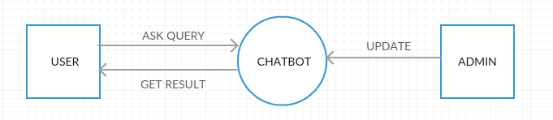
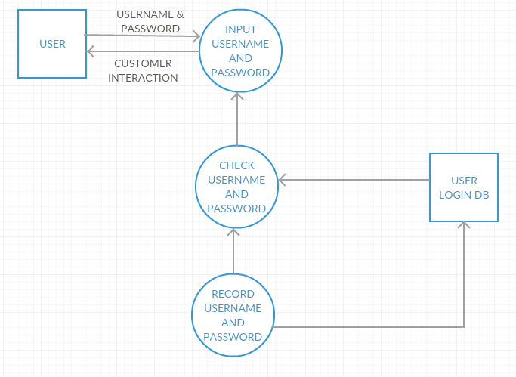
Architectural Design DFD Diagram
Level 0
Level 1

Slide 7
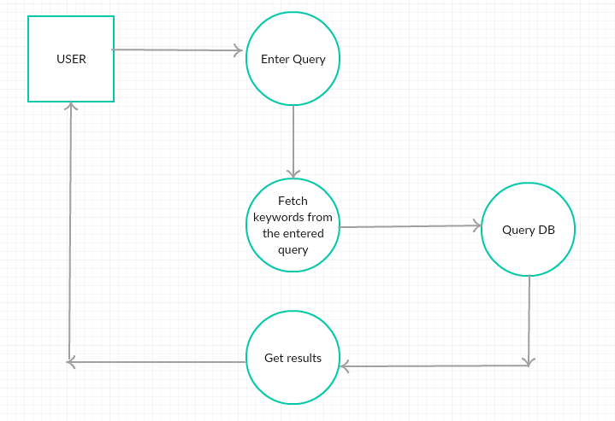
Architectural Design
Level 2
Department of CSE, KGiSL Institute of Technology, Coimbatore

Slide 8
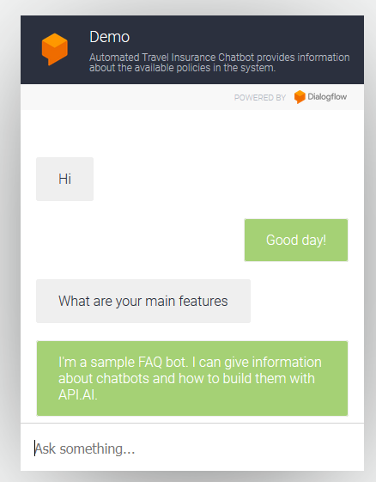
Architectural Design (ER diagram)
User Information
Gets to know the user
Bot process 1
Knowing the intent and responding
Bot Process 2
Knowing about the bot
Bot Process 3
Analyzing the question and responding
Department of CSE, KGiSL Institute of Technology, Coimbatore

Slide 9
Module Splitup
Module 1 :
Collecting Data set
Training the Chatbot
Module 2:
Building Chatbot
Developing Front end
Module 3:
Integrating
Department of CSE, KGiSL Institute of Technology, Coimbatore

Slide 10
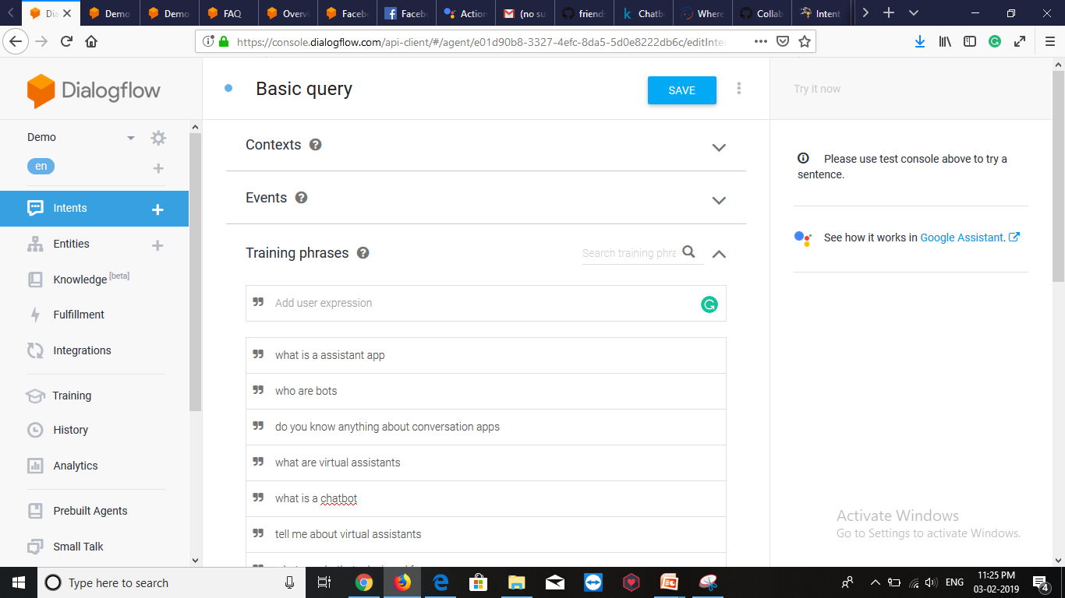
Screen shots of modules under progress. Dialogflow training page:
Department of CSE, KGiSL Institute of Technology, Coimbatore

Slide 11
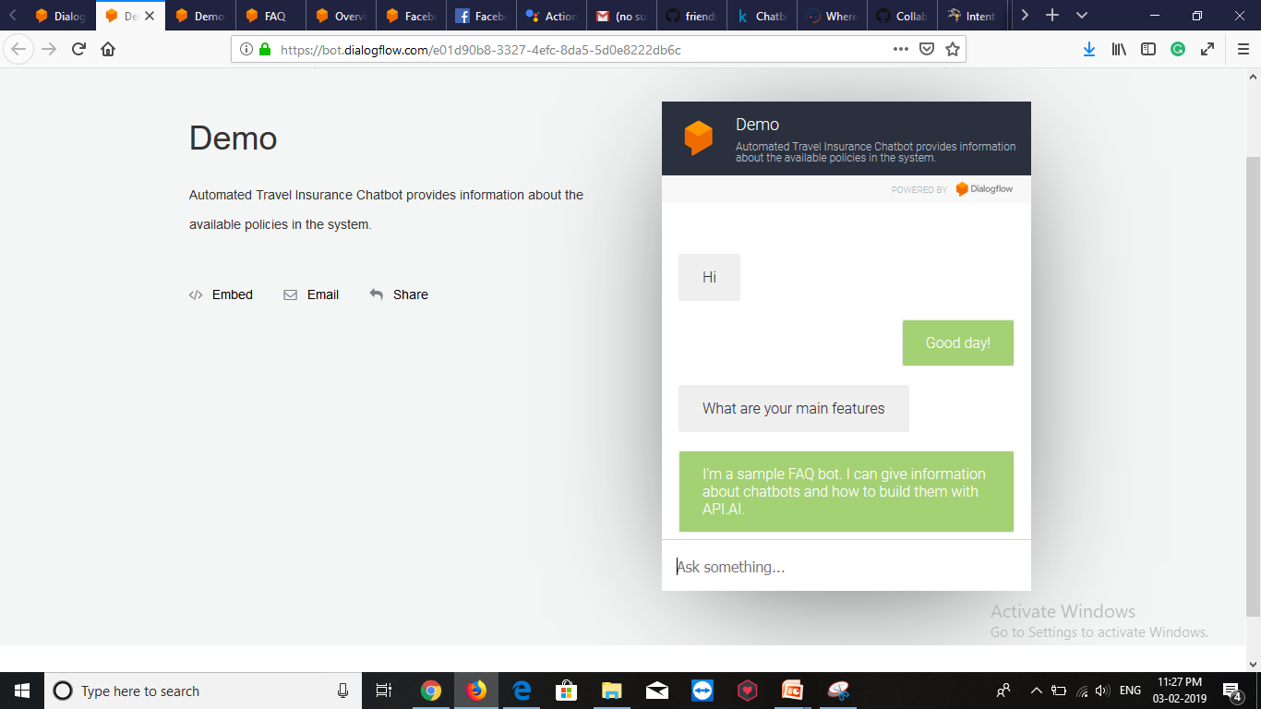
Running chatbot in web:

Slide 12
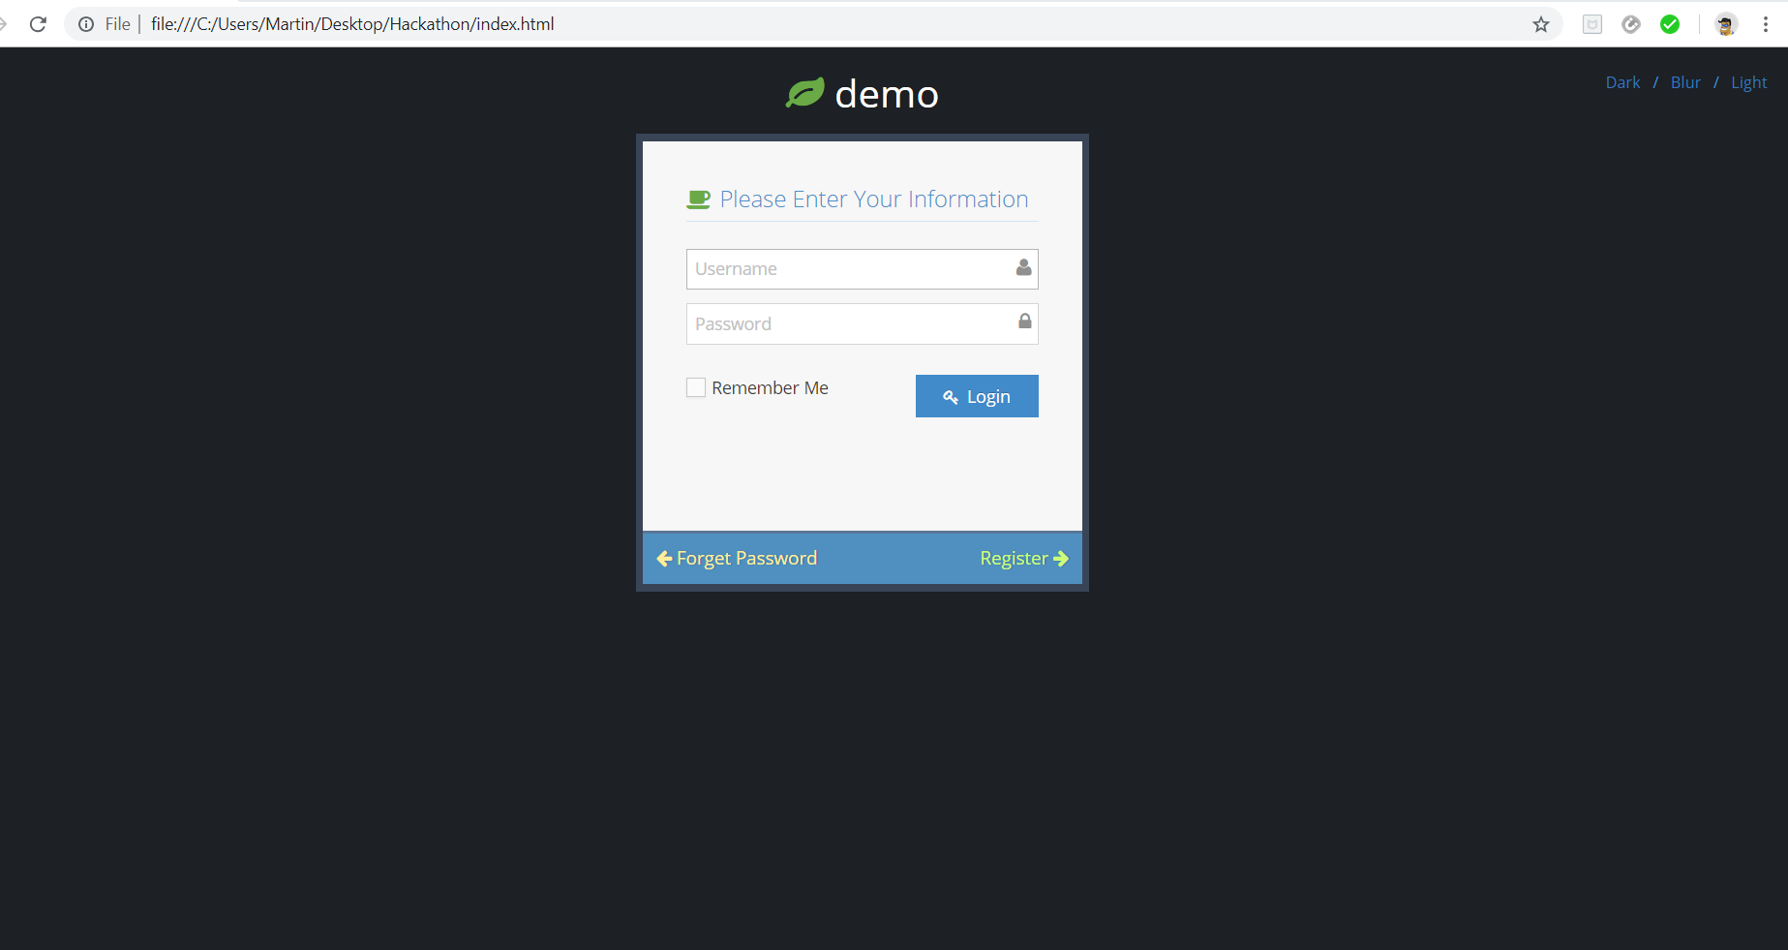
Login Page

Slide 13
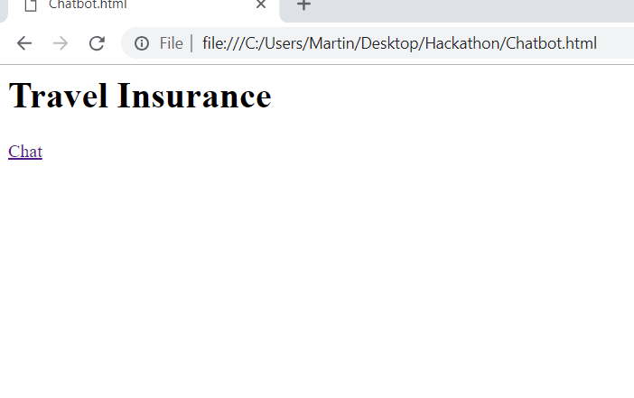
First page of the website

Slide 14
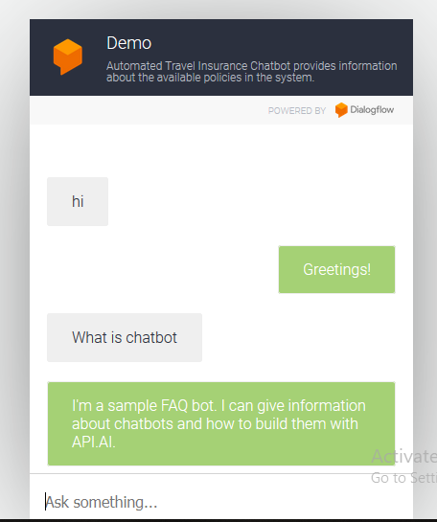
Chatbot after clicking the chat option:

Slide 15
Thank You

